Slide 1
More on Semaphores
Andy Wang
Operating Systems
COP 4610 / CGS 5765

Slide 2
The Pigeon Network Scenario
Pigeons are good message carriers
  Reasonably reliable
  Relatively fast for less developed rural areas
  Can sense magnetic field lines

Slide 3
Here is the Story…
There are two towns—Mars and Venus
  Mars has all male pigeons
  Venus has all female pigeons
Each town delivers messages to the other
  By sending a pigeon through the shared flying path
  And waiting for the same pigeon to fly back as an acknowledgement

Slide 4
Here is the Story…
Based on experience
  Whenever both towns send messages simultaneously, the reliability drops significantly
  Pigeons of opposite genders decide to take excursions
Goals of a pigeon network:
  Efficiency
  Fairness

Slide 5
Developing the Solution
Can we map it to already solved problems?
Standard synchronization problems:
  Bounded buffer (producers and consumers)
  Fairness (readers and writers)
  Resource allocation (dining philosophers)
Pigeon network is under the reader-writer category

Slide 6
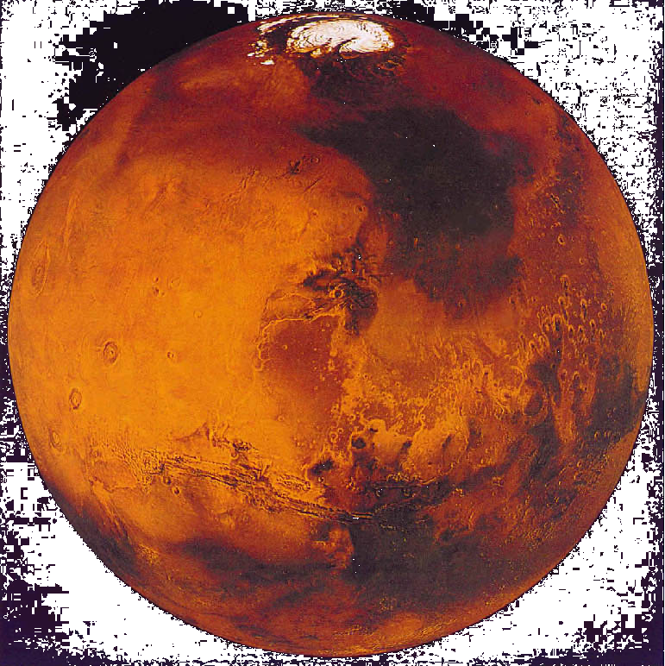
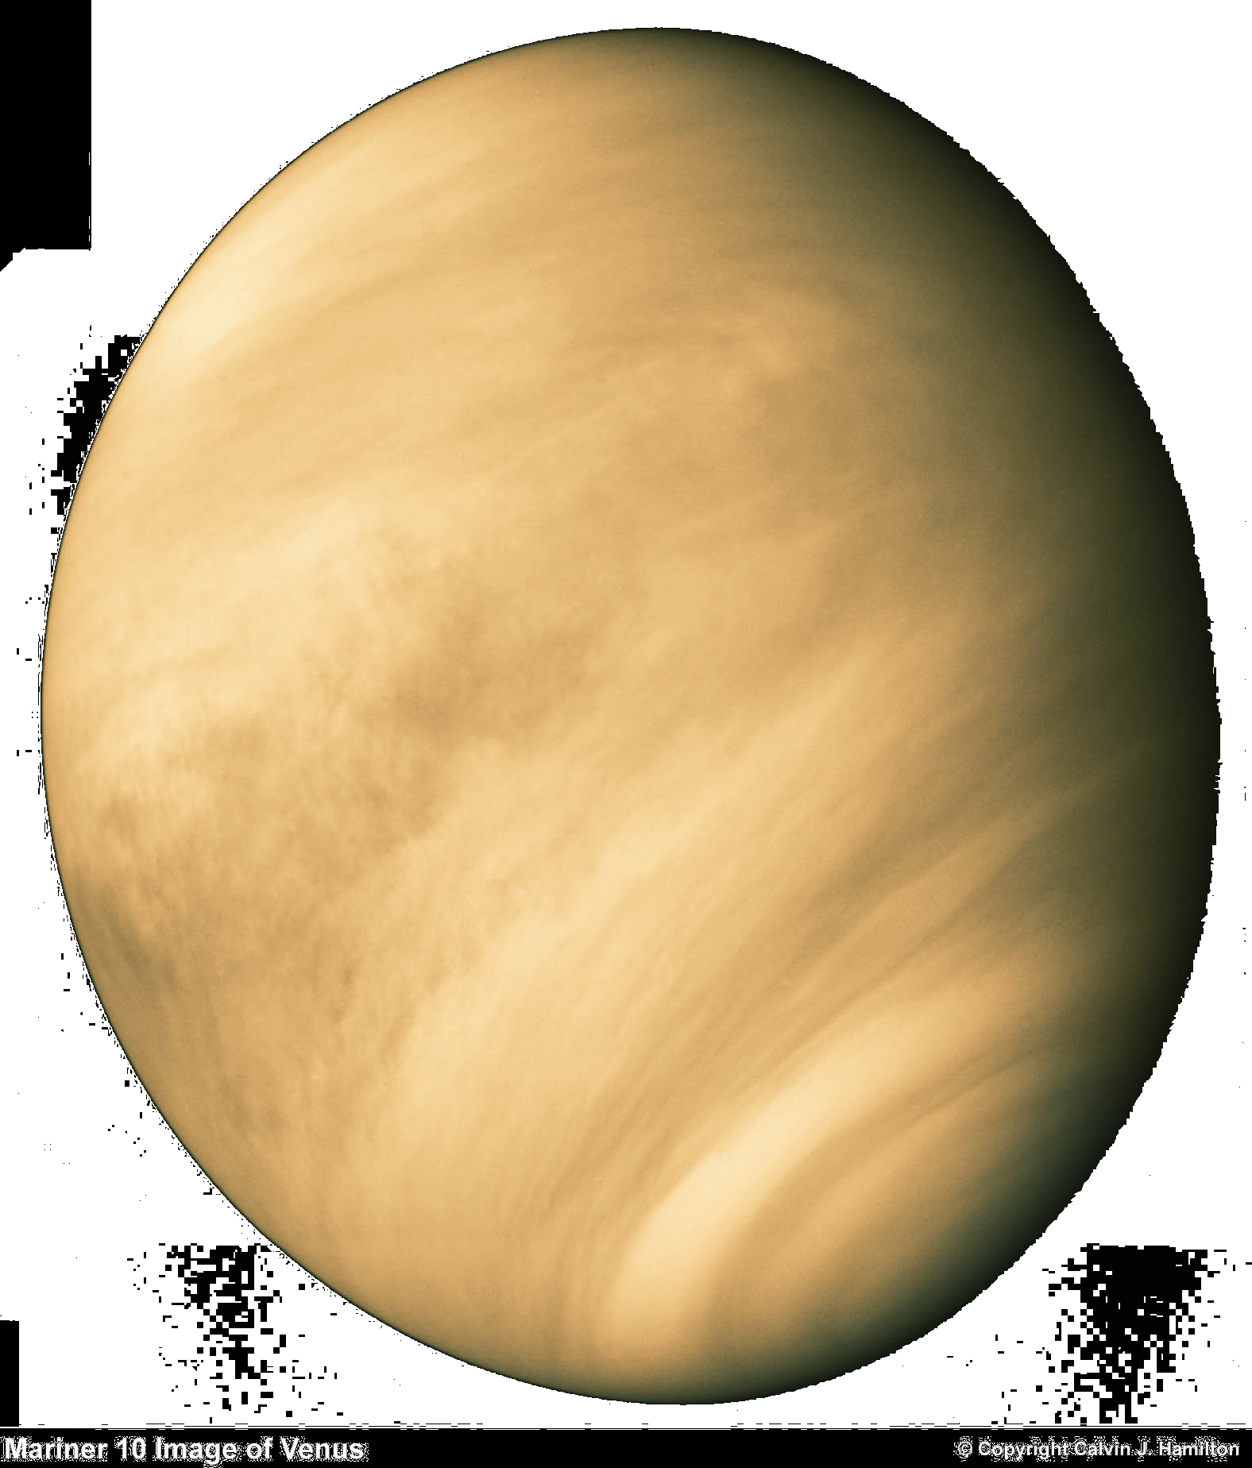
Step 1: Visualization
Identify
  Shared resources
  Scope of shared resources
flying path
Mars
Venus

Slide 7
Step 1: Visualization
Identify
  Shared resource: flying path
  Scope of the shared resource: global
flying path
Mars
Venus

Slide 8
Simplest Implementation
semaphore flyingPath = 1;
P(flyingPath);
// send the message
V(flyingPath);
P(flyingPath);
// send the message
V(flyingPath);
flying path
Mars
Venus

Slide 9
Simplest Implementation
semaphore flyingPath = 1;
P(flyingPath);
// send the message
V(flyingPath);
P(flyingPath);
// send the message
V(flyingPath);
flying path
Mars
Venus

Slide 10
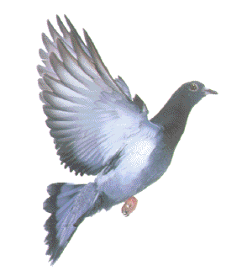
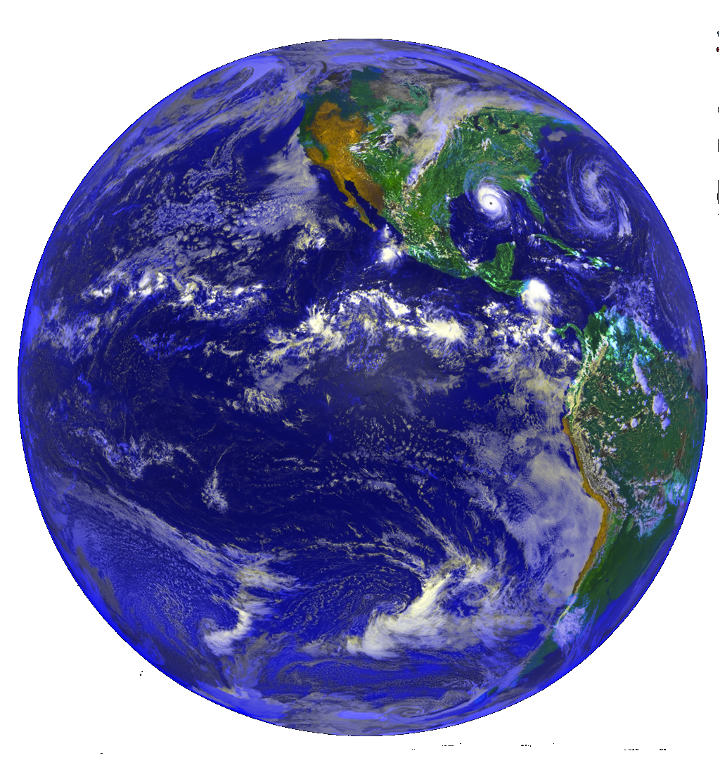
Simplest Implementation
semaphore flyingPath = 1;
P(flyingPath);
// send the message
V(flyingPath);
P(flyingPath);
// send the message
V(flyingPath);
flying path
something you don’t see everyday…
Mars
Venus

Slide 11
Simplest Implementation
semaphore flyingPath = 1;
P(flyingPath);
// send the message
V(flyingPath);
P(flyingPath);
// send the message
V(flyingPath);
flying path
Mars
Venus

Slide 12
Simplest Implementation
semaphore flyingPath = 1;
P(flyingPath);
// send the message
V(flyingPath);
P(flyingPath);
// send the message
V(flyingPath);
flying path
Mars
Venus

Slide 13
Simplest Implementation
semaphore flyingPath = 1;
P(flyingPath);
// send the message
V(flyingPath);
P(flyingPath);
// send the message
V(flyingPath);
flying path
Mars
Venus

Slide 14

Simplest Implementation
semaphore flyingPath = 1;
P(flyingPath);
// send the message
V(flyingPath);
P(flyingPath);
// send the message
V(flyingPath);
flying path
Mars
Venus

Slide 15
Simplest Implementation
semaphore flyingPath = 1;
P(flyingPath);
// send the message
V(flyingPath);
P(flyingPath);
// send the message
V(flyingPath);
flying path
Mars
Venus

Slide 16
Simplest Implementation
semaphore flyingPath = 1;
P(flyingPath);
// send the message
V(flyingPath);
P(flyingPath);
// send the message
V(flyingPath);
flying path
Mars
Venus

Slide 17
Simplest Implementation
+ Simple
+ Fair
- Not efficient
  Only one pigeon can fly at a time
  Venusians love to fly in groups…

Slide 18
Allowing Multiple Venusians in Transit
Resources and scopes: flying path (global), a counter for Venusians in transit (Venus)
flying path
Mars
Venus

Slide 19
Allowing Multiple Venusians in Transit
semaphore flyingPath = 1;
P(flyingPath);
// send the message
V(flyingPath);
int VenusiansInTransit = 0;
++VenusiansInTransit;
if (VenusiansInTransit == 1) {
P(flyingPath);
}
// send the message
--VenusiansInTransit;
if (VenusiansInTransit == 0) {
V(flyingPath);
}
flying path
Mars
Venus

Slide 20
Allowing Multiple Venusians in Transit
semaphore flyingPath = 1;
P(flyingPath);
// send the message
V(flyingPath);
int VenusiansInTransit = 0;
++VenusiansInTransit; // == 1
if (VenusiansInTransit == 1) {
P(flyingPath);
}
// send the message
--VenusiansInTransit;
if (VenusiansInTransit == 0) {
V(flyingPath);
}
flying path
Mars
Venus

Slide 21
Allowing Multiple Venusians in Transit
semaphore flyingPath = 1;
P(flyingPath);
// send the message
V(flyingPath);
int VenusiansInTransit = 0;
++VenusiansInTransit; // == 2
if (VenusiansInTransit == 1) {
P(flyingPath);
}
// send the message
--VenusiansInTransit;
if (VenusiansInTransit == 0) {
V(flyingPath);
}
flying path
Mars
Venus

Slide 22
Allowing Multiple Venusians in Transit
semaphore flyingPath = 1;
P(flyingPath);
// send the message
V(flyingPath);
int VenusiansInTransit = 0;
++VenusiansInTransit; // == 2
if (VenusiansInTransit == 1) {
P(flyingPath);
}
// send the message
--VenusiansInTransit;
if (VenusiansInTransit == 0) {
V(flyingPath);
}
flying path
Mars
Venus

Slide 23
Allowing Multiple Venusians in Transit
semaphore flyingPath = 1;
P(flyingPath);
// send the message
V(flyingPath);
int VenusiansInTransit = 0;
++VenusiansInTransit; // == 2
if (VenusiansInTransit == 1) {
P(flyingPath);
}
// send the message
--VenusiansInTransit;
if (VenusiansInTransit == 0) {
V(flyingPath);
}
flying path
Mars
Venus

Slide 24
Allowing Multiple Venusians in Transit
semaphore flyingPath = 1;
P(flyingPath);
// send the message
V(flyingPath);
int VenusiansInTransit = 0;
++VenusiansInTransit;
if (VenusiansInTransit == 1) {
P(flyingPath);
}
// send the message
--VenusiansInTransit;
if (VenusiansInTransit == 0) {
V(flyingPath);
}
flying path
Mars
Venus

Slide 25
Allowing Multiple Venusians in Transit
semaphore flyingPath = 1;
P(flyingPath);
// send the message
V(flyingPath);
int VenusiansInTransit = 0;
++VenusiansInTransit;
if (VenusiansInTransit == 1) {
P(flyingPath);
}
// send the message
--VenusiansInTransit;
if (VenusiansInTransit == 0) {
V(flyingPath);
}
flying path
Mars
Venus

Slide 26
Allowing Multiple Venusians in Transit
semaphore flyingPath = 1;
P(flyingPath);
// send the message
V(flyingPath);
int VenusiansInTransit = 0;
++VenusiansInTransit;
if (VenusiansInTransit == 1) {
P(flyingPath);
}
// send the message
--VenusiansInTransit;
if (VenusiansInTransit == 0) {
V(flyingPath);
}
Date?
Sure.
flying path
Mars
Venus

Slide 27
Allowing Multiple Venusians in Transit Revised
semaphore flyingPath = 1;
P(flyingPath);
// send the message
V(flyingPath);
semaphore VenusianLock = 1;
int VenusiansInTransit = 0;
P(VenusianLock);
++VenusiansInTransit;
if (VenusiansInTransit == 1) {
P(flyingPath);
}
// send the message
--VenusiansInTransit;
if (VenusiansInTransit == 0) {
V(flyingPath);
}
V(VenusianLock);
flying path
Mars
Venus

Slide 28
Allowing Multiple Venusians in Transit Revised
semaphore flyingPath = 1;
P(flyingPath);
// send the message
V(flyingPath);
semaphore VenusianLock = 1;
int VenusiansInTransit = 0;
P(VenusianLock);
++VenusiansInTransit;
if (VenusiansInTransit == 1) {
P(flyingPath);
}
// send the message
--VenusiansInTransit;
if (VenusiansInTransit == 0) {
V(flyingPath);
}
V(VenusianLock);
flying path
Mars
Venus

Slide 29
Allowing Multiple Venusians in Transit Revised
semaphore flyingPath = 1;
P(flyingPath);
// send the message
V(flyingPath);
semaphore VenusianLock = 1;
int VenusiansInTransit = 0;
P(VenusianLock);
++VenusiansInTransit;
if (VenusiansInTransit == 1) {
P(flyingPath);
}
// send the message
--VenusiansInTransit;
if (VenusiansInTransit == 0) {
V(flyingPath);
}
V(VenusianLock);
flying path
Mars
Venus

Slide 30
Allowing Multiple Venusians in Transit Revised
semaphore flyingPath = 1;
P(flyingPath);
// send the message
V(flyingPath);
semaphore VenusianLock = 1;
int VenusiansInTransit = 0;
P(VenusianLock);
++VenusiansInTransit;
if (VenusiansInTransit == 1) {
P(flyingPath);
}
// send the message
--VenusiansInTransit;
if (VenusiansInTransit == 0) {
V(flyingPath);
}
V(VenusianLock);
Wait!
flying path
Mars
Venus

Slide 31
Allowing Multiple Venusians in Transit Revised Again
semaphore flyingPath = 1;
P(flyingPath);
// send the message
V(flyingPath);
semaphore VenusianLock = 1;
int VenusiansInTransit = 0;
P(VenusianLock);
++VenusiansInTransit;
if (VenusiansInTransit == 1) {
P(flyingPath);
}
V(VenusianLock);
// send the message
P(VenusianLock);
--VenusiansInTransit;
if (VenusiansInTransit == 0) {
V(flyingPath);
}
V(VenusianLock);
flying path
Mars
Venus

Slide 32
Allowing Multiple Venusians in Transit Revised Again
semaphore flyingPath = 1;
P(flyingPath);
// send the message
V(flyingPath);
semaphore VenusianLock = 1;
int VenusiansInTransit = 0;
P(VenusianLock);
++VenusiansInTransit;
if (VenusiansInTransit == 1) {
P(flyingPath);
}
V(VenusianLock);
// send the message
P(VenusianLock);
--VenusiansInTransit;
if (VenusiansInTransit == 0) {
V(flyingPath);
}
V(VenusianLock);
flying path
Mars
Venus

Slide 33
Allowing Multiple Venusians in Transit Revised Again
semaphore flyingPath = 1;
P(flyingPath);
// send the message
V(flyingPath);
semaphore VenusianLock = 1;
int VenusiansInTransit = 0;
P(VenusianLock);
++VenusiansInTransit;
if (VenusiansInTransit == 1) {
P(flyingPath);
}
V(VenusianLock);
// send the message
P(VenusianLock);
--VenusiansInTransit;
if (VenusiansInTransit == 0) {
V(flyingPath);
}
V(VenusianLock);
flying path
Mars
Venus

Slide 34
Allowing Multiple Venusians in Transit Revised Again
semaphore flyingPath = 1;
P(flyingPath);
// send the message
V(flyingPath);
semaphore VenusianLock = 1;
int VenusiansInTransit = 0;
P(VenusianLock);
++VenusiansInTransit;
if (VenusiansInTransit == 1) {
P(flyingPath);
}
V(VenusianLock);
// send the message
P(VenusianLock);
--VenusiansInTransit;
if (VenusiansInTransit == 0) {
V(flyingPath);
}
V(VenusianLock);
flying path
Mars
Venus

Slide 35
Allowing Multiple Venusians in Transit Revised Again
semaphore flyingPath = 1;
P(flyingPath);
// send the message
V(flyingPath);
semaphore VenusianLock = 1;
int VenusiansInTransit = 0;
P(VenusianLock);
++VenusiansInTransit;
if (VenusiansInTransit == 1) {
P(flyingPath);
}
V(VenusianLock);
// send the message
P(VenusianLock);
--VenusiansInTransit;
if (VenusiansInTransit == 0) {
V(flyingPath);
}
V(VenusianLock);
flying path
Mars
Venus

Slide 36
Allowing Multiple Venusians in Transit Revised Again
semaphore flyingPath = 1;
P(flyingPath);
// send the message
V(flyingPath);
semaphore VenusianLock = 1;
int VenusiansInTransit = 0;
P(VenusianLock);
++VenusiansInTransit;
if (VenusiansInTransit == 1) {
P(flyingPath);
}
V(VenusianLock);
// send the message
P(VenusianLock);
--VenusiansInTransit;
if (VenusiansInTransit == 0) {
V(flyingPath);
}
V(VenusianLock);
flying path
Mars
Venus

Slide 37
Allowing Multiple Venusians in Transit Revised Again
semaphore flyingPath = 1;
P(flyingPath);
// send the message
V(flyingPath);
semaphore VenusianLock = 1;
int VenusiansInTransit = 0;
P(VenusianLock);
++VenusiansInTransit;
if (VenusiansInTransit == 1) {
P(flyingPath);
}
V(VenusianLock);
// send the message
P(VenusianLock);
--VenusiansInTransit;
if (VenusiansInTransit == 0) {
V(flyingPath);
}
V(VenusianLock);
flying path
Mars
Venus

Slide 38
Allowing Multiple Venusians in Transit Revised Again
semaphore flyingPath = 1;
P(flyingPath);
// send the message
V(flyingPath);
semaphore VenusianLock = 1;
int VenusiansInTransit = 0;
P(VenusianLock);
++VenusiansInTransit;
if (VenusiansInTransit == 1) {
P(flyingPath);
}
V(VenusianLock);
// send the message
P(VenusianLock);
--VenusiansInTransit;
if (VenusiansInTransit == 0) {
V(flyingPath);
}
V(VenusianLock);
flying path
Mars
Venus

Slide 39
Allowing Multiple Venusians in Transit Revised Again
semaphore flyingPath = 1;
P(flyingPath);
// send the message
V(flyingPath);
semaphore VenusianLock = 1;
int VenusiansInTransit = 0;
P(VenusianLock);
++VenusiansInTransit;
if (VenusiansInTransit == 1) {
P(flyingPath);
}
V(VenusianLock);
// send the message
P(VenusianLock);
--VenusiansInTransit;
if (VenusiansInTransit == 0) {
V(flyingPath);
}
V(VenusianLock);
flying path
Mars
Venus

Slide 40
Allowing Multiple Venusians in Transit Revised Again
semaphore flyingPath = 1;
P(flyingPath);
// send the message
V(flyingPath);
semaphore VenusianLock = 1;
int VenusiansInTransit = 0;
P(VenusianLock);
++VenusiansInTransit;
if (VenusiansInTransit == 1) {
P(flyingPath);
}
V(VenusianLock);
// send the message
P(VenusianLock);
--VenusiansInTransit;
if (VenusiansInTransit == 0) {
V(flyingPath);
}
V(VenusianLock);
flying path
Mars
Venus

Slide 41
Allowing Multiple Venusians in Transit Revised Again
semaphore flyingPath = 1;
P(flyingPath);
// send the message
V(flyingPath);
semaphore VenusianLock = 1;
int VenusiansInTransit = 0;
P(VenusianLock);
++VenusiansInTransit;
if (VenusiansInTransit == 1) {
P(flyingPath);
}
V(VenusianLock);
// send the message
P(VenusianLock);
--VenusiansInTransit;
if (VenusiansInTransit == 0) {
V(flyingPath);
}
V(VenusianLock);
flying path
Mars
Venus

Slide 42
Allowing Multiple Venusians in Transit Revised Again
semaphore flyingPath = 1;
P(flyingPath);
// send the message
V(flyingPath);
semaphore VenusianLock = 1;
int VenusiansInTransit = 0;
P(VenusianLock);
++VenusiansInTransit;
if (VenusiansInTransit == 1) {
P(flyingPath);
}
V(VenusianLock);
// send the message
P(VenusianLock);
--VenusiansInTransit;
if (VenusiansInTransit == 0) {
V(flyingPath);
}
V(VenusianLock);
flying path
Mars
Venus

Slide 43
Allowing Multiple Venusians in Transit Revised Again
semaphore flyingPath = 1;
P(flyingPath);
// send the message
V(flyingPath);
semaphore VenusianLock = 1;
int VenusiansInTransit = 0;
P(VenusianLock);
++VenusiansInTransit;
if (VenusiansInTransit == 1) {
P(flyingPath);
}
V(VenusianLock);
// send the message
P(VenusianLock);
--VenusiansInTransit;
if (VenusiansInTransit == 0) {
V(flyingPath);
}
V(VenusianLock);
flying path
Mars
Venus

Slide 44
Allowing Multiple Venusians in Transit Revised Again
semaphore flyingPath = 1;
P(flyingPath);
// send the message
V(flyingPath);
semaphore VenusianLock = 1;
int VenusiansInTransit = 0;
P(VenusianLock);
++VenusiansInTransit;
if (VenusiansInTransit == 1) {
P(flyingPath);
}
V(VenusianLock);
// send the message
P(VenusianLock);
--VenusiansInTransit;
if (VenusiansInTransit == 0) {
V(flyingPath);
}
V(VenusianLock);
flying path
Mars
Venus

Slide 45
Allowing Multiple Venusians in Transit Revised Again
semaphore flyingPath = 1;
P(flyingPath);
// send the message
V(flyingPath);
semaphore VenusianLock = 1;
int VenusiansInTransit = 0;
P(VenusianLock);
++VenusiansInTransit;
if (VenusiansInTransit == 1) {
P(flyingPath);
}
V(VenusianLock);
// send the message
P(VenusianLock);
--VenusiansInTransit;
if (VenusiansInTransit == 0) {
V(flyingPath);
}
V(VenusianLock);
flying path
Mars
Venus

Slide 46
Allowing Multiple Venusians in Transit Revised Again
semaphore flyingPath = 1;
P(flyingPath);
// send the message
V(flyingPath);
semaphore VenusianLock = 1;
int VenusiansInTransit = 0;
P(VenusianLock);
++VenusiansInTransit;
if (VenusiansInTransit == 1) {
P(flyingPath);
}
V(VenusianLock);
// send the message
P(VenusianLock);
--VenusiansInTransit;
if (VenusiansInTransit == 0) {
V(flyingPath);
}
V(VenusianLock);
flying path
Mars
Venus

Slide 47
Allowing Multiple Venusians in Transit Revised Again
semaphore flyingPath = 1;
P(flyingPath);
// send the message
V(flyingPath);
semaphore VenusianLock = 1;
int VenusiansInTransit = 0;
P(VenusianLock);
++VenusiansInTransit;
if (VenusiansInTransit == 1) {
P(flyingPath);
}
V(VenusianLock);
// send the message
P(VenusianLock);
--VenusiansInTransit;
if (VenusiansInTransit == 0) {
V(flyingPath);
}
V(VenusianLock);
flying path
Mars
Venus

Slide 48
Allowing Multiple Venusians in Transit Revised Again
semaphore flyingPath = 1;
P(flyingPath);
// send the message
V(flyingPath);
semaphore VenusianLock = 1;
int VenusiansInTransit = 0;
P(VenusianLock);
++VenusiansInTransit;
if (VenusiansInTransit == 1) {
P(flyingPath);
}
V(VenusianLock);
// send the message
P(VenusianLock);
--VenusiansInTransit;
if (VenusiansInTransit == 0) {
V(flyingPath);
}
V(VenusianLock);
flying path
Mars
Venus

Slide 49
Allowing Multiple Venusians in Transit Revised Again
semaphore flyingPath = 1;
P(flyingPath);
// send the message
V(flyingPath);
semaphore VenusianLock = 1;
int VenusiansInTransit = 0;
P(VenusianLock);
++VenusiansInTransit;
if (VenusiansInTransit == 1) {
P(flyingPath);
}
V(VenusianLock);
// send the message
P(VenusianLock);
--VenusiansInTransit;
if (VenusiansInTransit == 0) {
V(flyingPath);
}
V(VenusianLock);
flying path
Mars
Venus

Slide 50
Allowing Multiple Venusians in Transit Revised Again
semaphore flyingPath = 1;
P(flyingPath);
// send the message
V(flyingPath);
semaphore VenusianLock = 1;
int VenusiansInTransit = 0;
P(VenusianLock);
++VenusiansInTransit;
if (VenusiansInTransit == 1) {
P(flyingPath);
}
V(VenusianLock);
// send the message
P(VenusianLock);
--VenusiansInTransit;
if (VenusiansInTransit == 0) {
V(flyingPath);
}
V(VenusianLock);
flying path
Mars
Venus

Slide 51
Allowing Multiple Venusians in Transit Revised Again
semaphore flyingPath = 1;
P(flyingPath);
// send the message
V(flyingPath);
semaphore VenusianLock = 1;
int VenusiansInTransit = 0;
P(VenusianLock);
++VenusiansInTransit;
if (VenusiansInTransit == 1) {
P(flyingPath);
}
V(VenusianLock);
// send the message
P(VenusianLock);
--VenusiansInTransit;
if (VenusiansInTransit == 0) {
V(flyingPath);
}
V(VenusianLock);
flying path
Mars
Venus

Slide 52
Allowing Multiple Venusians in Transit Revised Again
semaphore flyingPath = 1;
P(flyingPath);
// send the message
V(flyingPath);
semaphore VenusianLock = 1;
int VenusiansInTransit = 0;
P(VenusianLock);
++VenusiansInTransit;
if (VenusiansInTransit == 1) {
P(flyingPath);
}
V(VenusianLock);
// send the message
P(VenusianLock);
--VenusiansInTransit;
if (VenusiansInTransit == 0) {
V(flyingPath);
}
V(VenusianLock);
flying path
Mars
Venus

Slide 53
Allowing Multiple Venusians in Transit Revised Again
semaphore flyingPath = 1;
P(flyingPath);
// send the message
V(flyingPath);
semaphore VenusianLock = 1;
int VenusiansInTransit = 0;
P(VenusianLock);
++VenusiansInTransit;
if (VenusiansInTransit == 1) {
P(flyingPath);
}
V(VenusianLock);
// send the message
P(VenusianLock);
--VenusiansInTransit;
if (VenusiansInTransit == 0) {
V(flyingPath);
}
V(VenusianLock);
flying path
Mars
Venus

Slide 54
Allowing Multiple Venusians in Transit Revised Again
semaphore flyingPath = 1;
P(flyingPath);
// send the message
V(flyingPath);
semaphore VenusianLock = 1;
int VenusiansInTransit = 0;
P(VenusianLock);
++VenusiansInTransit;
if (VenusiansInTransit == 1) {
P(flyingPath);
}
V(VenusianLock);
// send the message
P(VenusianLock);
--VenusiansInTransit;
if (VenusiansInTransit == 0) {
V(flyingPath);
}
V(VenusianLock);
flying path
Mars
Venus

Slide 55
Allowing Multiple Venusians in Transit Revised Again
semaphore flyingPath = 1;
P(flyingPath);
// send the message
V(flyingPath);
semaphore VenusianLock = 1;
int VenusiansInTransit = 0;
P(VenusianLock);
++VenusiansInTransit;
if (VenusiansInTransit == 1) {
P(flyingPath);
}
V(VenusianLock);
// send the message
P(VenusianLock);
--VenusiansInTransit;
if (VenusiansInTransit == 0) {
V(flyingPath);
}
V(VenusianLock);
flying path
Mars
Venus

Slide 56
Allowing Multiple Venusians in Transit Revised Again
semaphore flyingPath = 1;
P(flyingPath);
// send the message
V(flyingPath);
semaphore VenusianLock = 1;
int VenusiansInTransit = 0;
P(VenusianLock);
++VenusiansInTransit;
if (VenusiansInTransit == 1) {
P(flyingPath);
}
V(VenusianLock);
// send the message
P(VenusianLock);
--VenusiansInTransit;
if (VenusiansInTransit == 0) {
V(flyingPath);
}
V(VenusianLock);
flying path
Mars
Venus

Slide 57
Allowing Multiple Venusians in Transit Revised Again
semaphore flyingPath = 1;
P(flyingPath);
// send the message
V(flyingPath);
semaphore VenusianLock = 1;
int VenusiansInTransit = 0;
P(VenusianLock);
++VenusiansInTransit;
if (VenusiansInTransit == 1) {
P(flyingPath);
}
V(VenusianLock);
// send the message
P(VenusianLock);
--VenusiansInTransit;
if (VenusiansInTransit == 0) {
V(flyingPath);
}
V(VenusianLock);
flying path
Mars
Venus

Slide 58
Allowing Multiple Venusians in Transit Revised Again
semaphore flyingPath = 1;
P(flyingPath);
// send the message
V(flyingPath);
semaphore VenusianLock = 1;
int VenusiansInTransit = 0;
P(VenusianLock);
++VenusiansInTransit;
if (VenusiansInTransit == 1) {
P(flyingPath);
}
V(VenusianLock);
// send the message
P(VenusianLock);
--VenusiansInTransit;
if (VenusiansInTransit == 0) {
V(flyingPath);
}
V(VenusianLock);
flying path
Mars
Venus

Slide 59
Allowing Multiple Venusians in Transit Revised Again
semaphore flyingPath = 1;
P(flyingPath);
// send the message
V(flyingPath);
semaphore VenusianLock = 1;
int VenusiansInTransit = 0;
P(VenusianLock);
++VenusiansInTransit;
if (VenusiansInTransit == 1) {
P(flyingPath);
}
V(VenusianLock);
// send the message
P(VenusianLock);
--VenusiansInTransit;
if (VenusiansInTransit == 0) {
V(flyingPath);
}
V(VenusianLock);
flying path
Mars
Venus

Slide 60
Allowing Multiple Venusians in Transit Revised Again
semaphore flyingPath = 1;
P(flyingPath);
// send the message
V(flyingPath);
semaphore VenusianLock = 1;
int VenusiansInTransit = 0;
P(VenusianLock);
++VenusiansInTransit;
if (VenusiansInTransit == 1) {
P(flyingPath);
}
V(VenusianLock);
// send the message
P(VenusianLock);
--VenusiansInTransit;
if (VenusiansInTransit == 0) {
V(flyingPath);
}
V(VenusianLock);
flying path
Mars
Venus

Slide 61
Allowing Multiple Venusians in Transit Revised Again
Efficient for Venusians
Not fair for Martians

Slide 62
Allowing Multiple Venusians and Martians in Transit
semaphore flyingPath = 1;
semaphore MartianLock = 1;
int MartiansInTransit = 0;
P(MartianLock);
++MartiansInTransit;
if (MartiansInTransit == 1) {
P(flyingPath);
}
V(MartianLock);
// send the message
P(MartianLock);
--MartiansInTransit;
if (MartiansInTransit == 0) {
V(flyingPath);
}
V(MartianLock);
semaphore VenusianLock = 1;
int VenusiansInTransit = 0;
P(VenusianLock);
++VenusiansInTransit;
if (VenusiansInTransit == 1) {
P(flyingPath);
}
V(VenusianLock);
// send the message
P(VenusianLock);
--VenusiansInTransit;
if (VenusiansInTransit == 0) {
V(flyingPath);
}
V(VenusianLock);

Slide 63
Allowing Multiple Venusians and Martians in Transit
Both sides can transmit efficiently
One side can completely block off the traffic from the other side
Fair, since both sides are equally selfish…
Fortunately, pigeons do sleep
Daily cycles will break a starvation condition…

Slide 64
Proving the Correctness
Safety (mutual exclusion):
  At most one thread is in the critical section at any time
  All necessary locks are acquired at the entrance of a critical section
  All shared resources are protected

Slide 65
Proving the Correctness
Liveness (progress):
  If more than one thread is interested in executing the critical section, some processes will eventually do so (deadlock free)
Fairness (bounded waiting):
  Every thread that wants to execute the critical section will eventually do so (no starvation)

Slide 66


